Slide 1
Catastrophe
Najim Mohammed
Konstantin Knaub
Benjamin To

Slide 2
Project review
Prediction of any future disaster, using arrays of bundled up with arrays of equipment and futuristic technologies.
Using AI and machine learning.

Slide 3
Target user audience
Travelers
People who live in a danger area
Workers in special services (Such as firefighters)
The average consumer, anyone with a smart device to access the internet.

Slide 4
Features
Top Ranked
A user can set the range in the specific area
Using of artificial intelligence and machine learning
Lowest Ranked
Constantly updating the data about danger risk in a specific location.

Slide 5
Initial and Revised wireframes

Slide 6
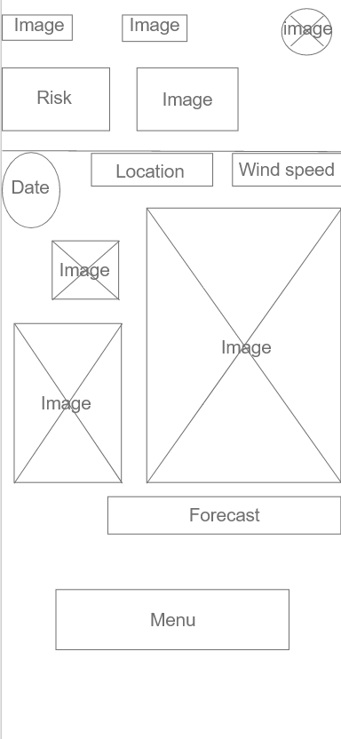
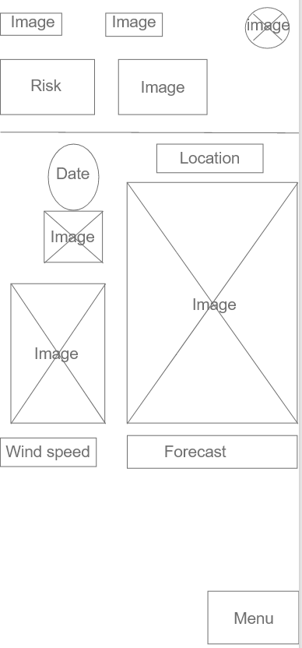
Home page
Some items were moved to other places for best layout.
We moved the “Menu” button to the bottom.
In our opinion it best suits there.

Slide 7
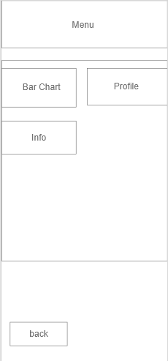
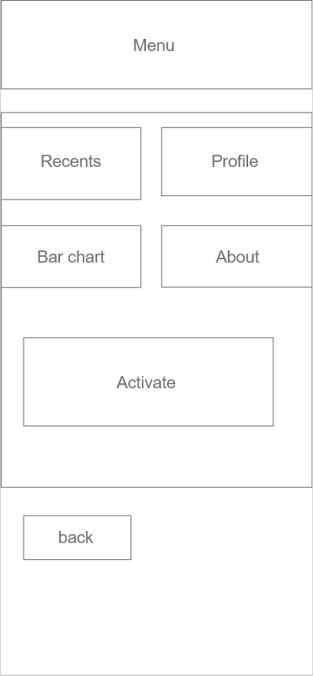
Menu page
We removed some unnecessary buttons, to make the interface in the profile page started looking convenient and understandable. We moved the “Activate button” to the home page and make it to actual weather forecast.

Slide 8
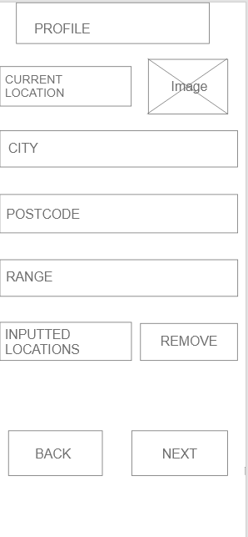
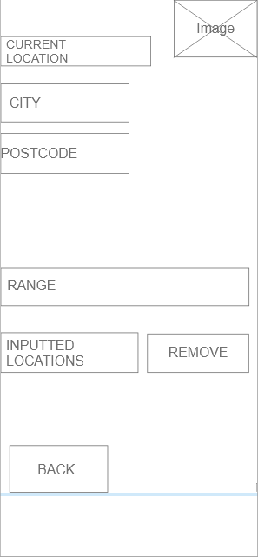
Profile page
After making significant changes in design, the interface in the profile page started looking beautiful for a human eye. The “next” button has been removed and now the user must scroll down to see the results.

Slide 9
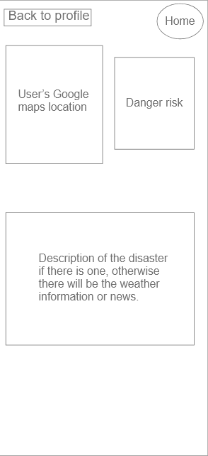
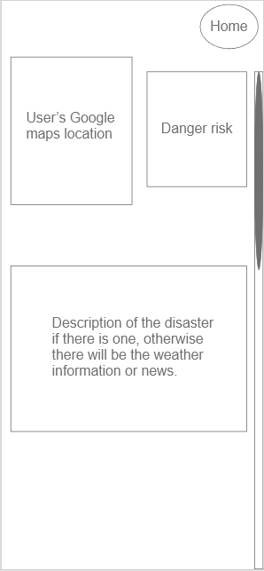
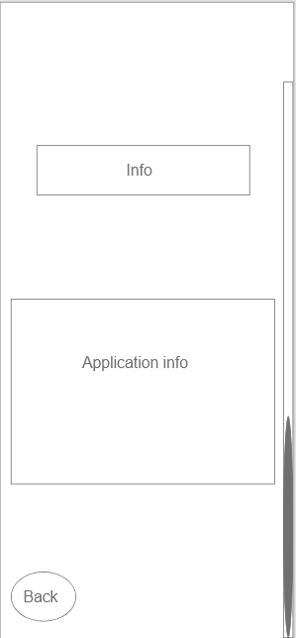
Result page
We removed the “Back to profile” button. Instead of this we just have “Home” button.

Slide 10
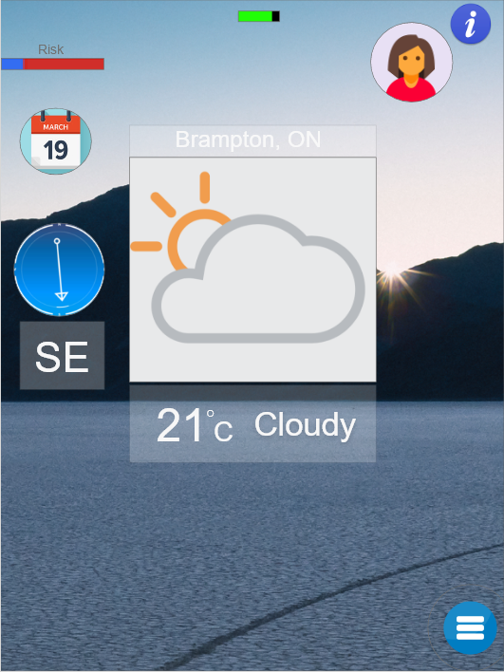
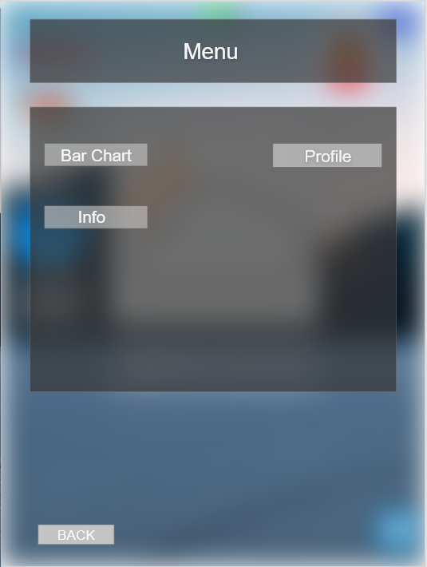
Final designs

Slide 11
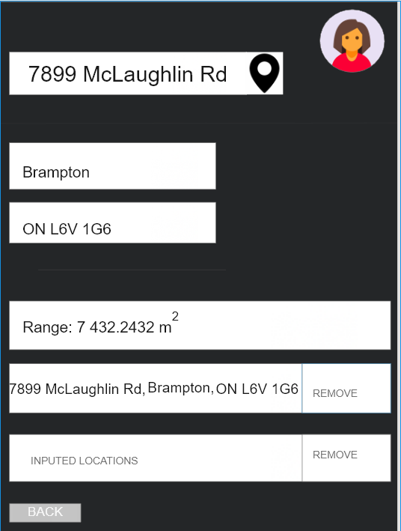
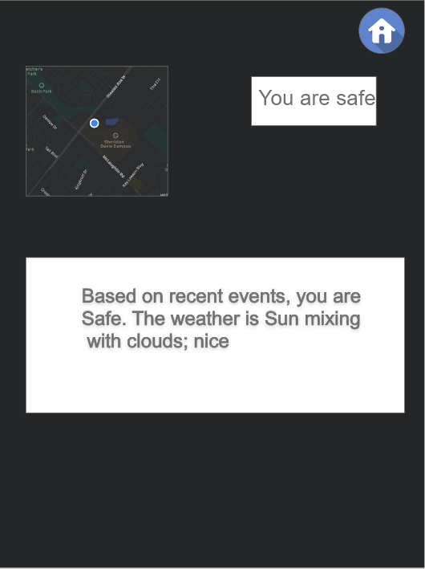
Final designs

Slide 12
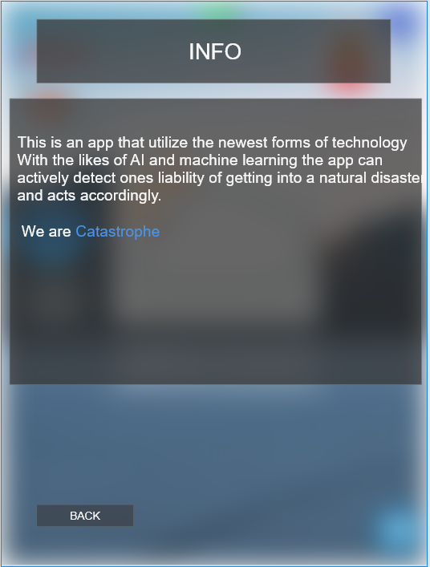
Final designs

Slide 13
Finding form user testing
Good points
Users completed all the tasks in testing
It’s easy to navigate through the application
The application is intuitive
Bad points
Too many buttons on the page, some of them are confusing
The old design cluttered
The menu page has a lot of redundant buttons
The “next” button on the profile page confused the users, after the set up of profile.(some users told us to add the “save” button.

Slide 14
Lessons learned
The smallest part of the design could indeed affect the perception of the app to the user.
We learnt that making the app intelligible could further enhance the user’s experience of the application.
We learnt that making the application unique gave us better feedback from the testers.
Allocating individual task to each of the group members improves work flow.
We learnt that color scheme is the backbone of design.

Slide 15
Next launch
The ability to add voice command while app is closed, using a key word “activate”.
The app would be integrated into the phones build-in weather app.
The app would have the function of making use of internet connection to run its functions instead of building cpu, making it accessible to anyone.
The app would be able to contact the emergency services when id detects the user to be incapacitated using ai. (event,disaster,fire)

